Slide 1

Meta Visit
Succesful Business Model for Meta-Visit
November 20, 2021
Nadia Hazar, Vinay Lohana, Jeongmin Lee

Slide 2

Introduction
Physician Shortage problem in B.C.
Frontline healthcare workers and administrators alike point to a significant issue of the ongoing family doctor shortage in British Columbia.
Physicians have to find and lease their own space, hire their own staff and source their own equipment and supplies; most spend many hours running their business and some have little desire to do so, preferring to solely focus on practicing medicine.

Slide 3
Identifying Power Users
Age
The higher the age, the higher the probability of being a power user
Preceived Health
The higher the age, the higher the probability of being a power user
Repetitive Strain injuries
On the Job Injuries are more probable in being a power user
Gave Birth Last 5 Years
If they have given birth in the last t5 years, the chances of being power users increases.

Slide 4
Financial Impact of Using Virtual Care

Slide 5
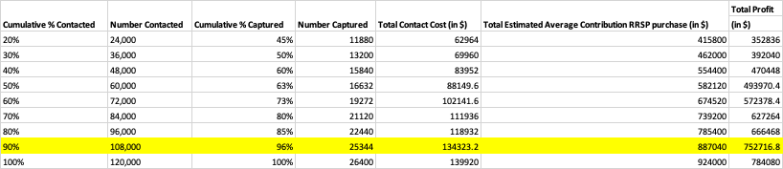
Profit and Cost Analysis
Telehealth GP Individual counseling: $65
General Physicians cost (Hiring GP for each session): $30
Contact cost (Mail and glossy brochure production cost): $5.30
Number of potential contacts (members without an MSP): 120,000
Estimated average contribution per MV D2C session purchase: $35

Slide 6

Important Predictors
An overview of the predictors that have significant predictive effects:

Slide 7
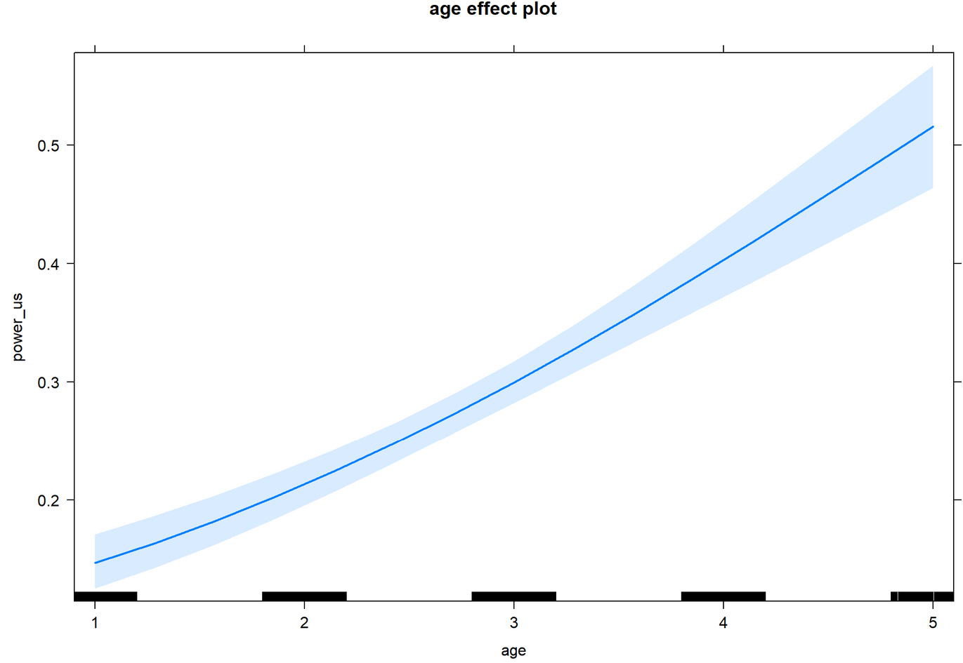
Age

Slide 8
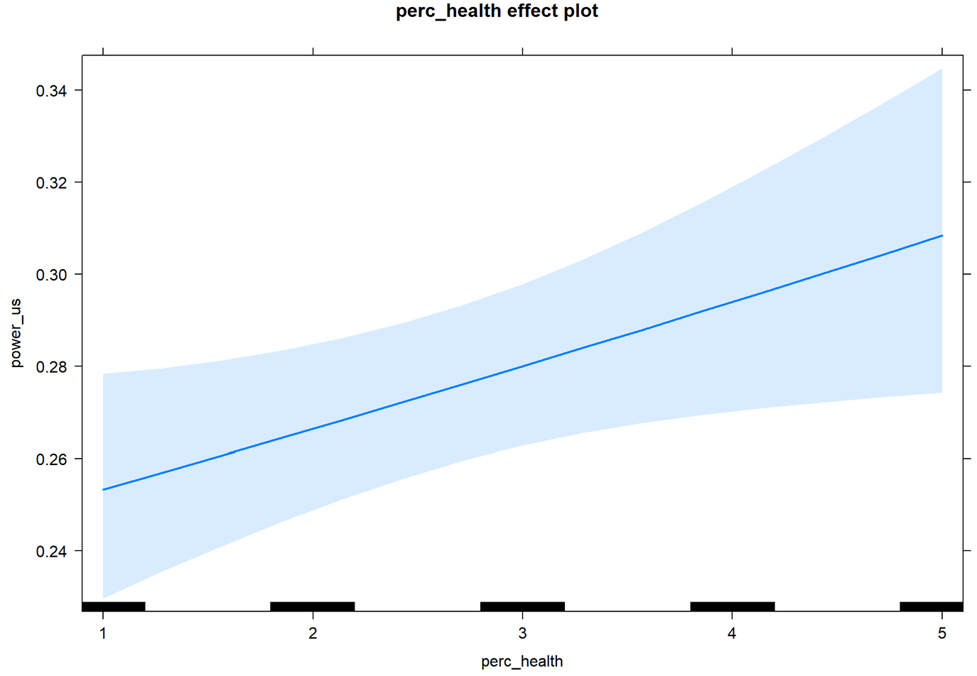
Perceived Health

Slide 9
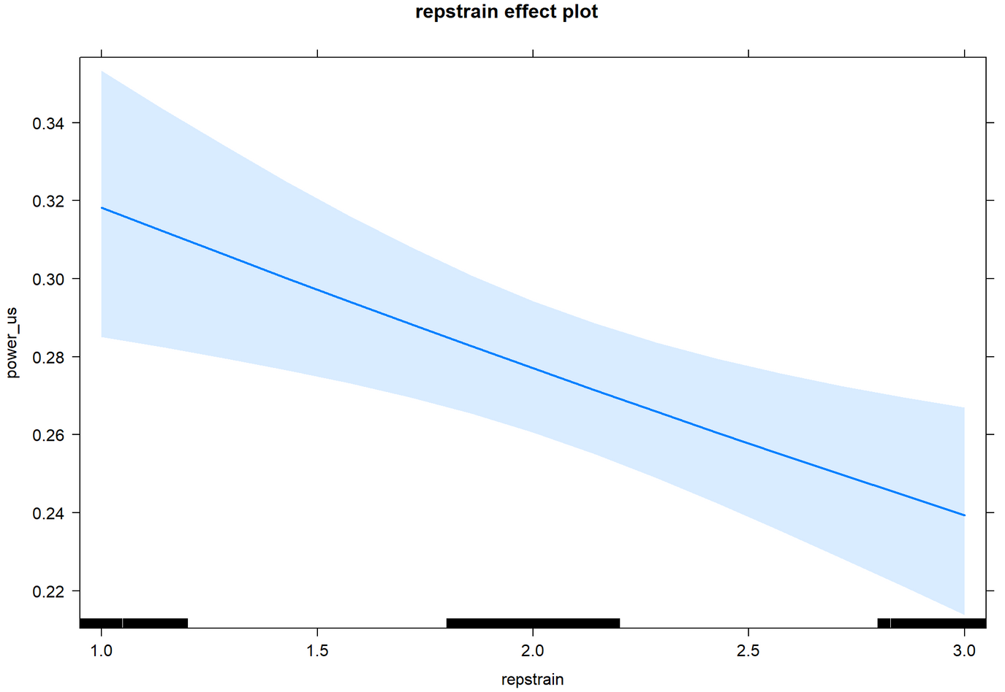
Repetitive Strain Injuries

Slide 10
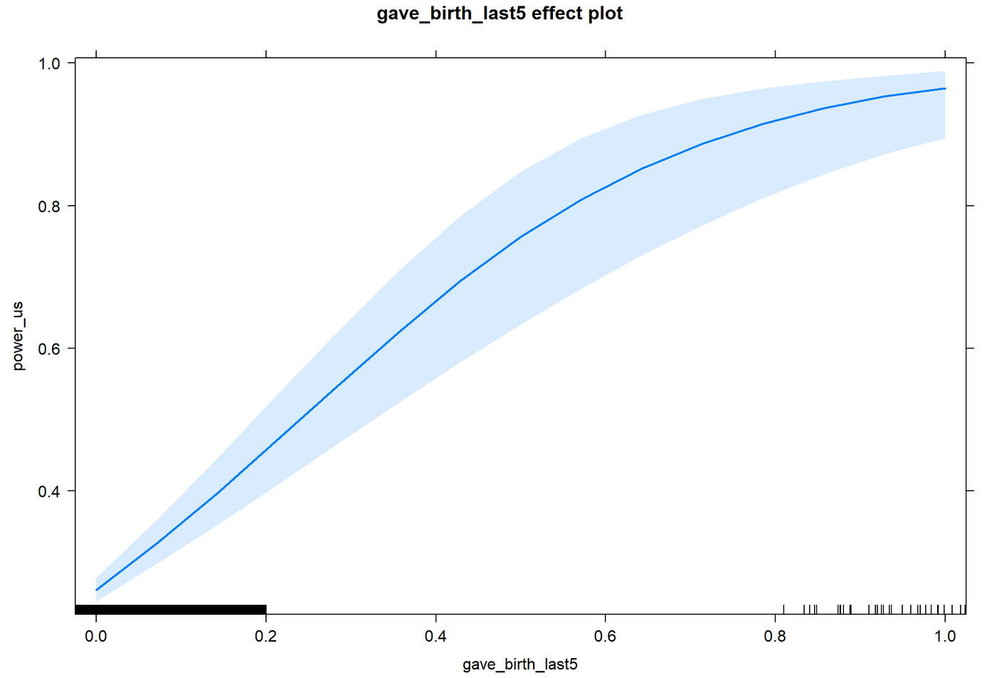
Gave birth Last 5 Years

